Slide 2
Recommended Action
Receive presentation on recommended adjustments to solid waste rates effective January 1, 2025
Set a public hearing for January 16, 2025, pursuant to Article XIIID of the California Constitution (Proposition 218)
Provide direction to issue 45-day notices to solid waste customers regarding rate adjustment public hearing and protest instructions

Slide 3
Executive Summary
Solid waste services are critical services and are required for health and safety as well as compliance with State laws
The District’s solid waste collection operations are contracted out to Mission Country Disposal (MCD) and are funded through solid waste rates
Rate revenues are adjusted per the District’s rate setting methodology – every 3 years based on MCD’s actual costs and otherwise annually by CPI
The District may authorize up to 5-years of solid waste rate adjustments at a time – there are no ongoing automatic adjustments outside of Board authorization

Slide 4
Executive Summary
Existing rate adjustment methodology was established in 1994 and is outdated
The last cost-based adjustment occurred in 2022, with CPI adjustments in 2023 and 2024
MCD submitted a cost-based rate adjustment application for 2025 per existing methodology and schedule
The District along 9 other Agencies in San Luis Obispo County and MCD’s parent company (Waste Connections) all see benefit in a new approach to annual rate adjustments

Slide 5
2025 Rate Adjustment and New Methodology
2025 Cost-Based Rate Adjustment
  Projects future costs based on recent actual costs per audited financial statements
  Increases in organics processing costs
  Increases in landfill disposal costs
  Inflation-related increases in collection costs
  Removal of prior limitations on corporate overhead
  Updated profit allowance
Notes:
A doubling of post-collection costs for organics processing since 2022 due to updated costs for processing infrastructure to meet the requirements of Senate Bill (SB) 1383.
Market rate adjustment of post-collection costs for landfill disposal, which have remained flat since 2016. Landfill disposal costs have been below market at $41 per ton since 2016 and will increase to a fair market cost of $70 per ton in 2025.
Cost-of-living changes in collection costs, which include labor, capital, operating expenses, insurance, and overhead costs, for 2025 increases over 2024 amounting to approximately 4.21%.
Additional costs for regional service enhancements

Slide 6
2025 Rate Adjustment and New Methodology
2025 Cost Projections
Cambria Community Services District | Original Adjustment | Revised Adjustment
Collection Services | $1,961,999 | $1,955,476
Profit Allowance | 170,609 | 175,993
Post-Collection Services | 828,185 | 828,185
Agency Fees | 267,905 | 263,809
Total Cost Projections | 3,228,699 | 3,223,463
Revenue at Current Rates | 2,882,493 | 2,882,493
Surplus / Shortfall | (346,206) | (340,970)
Franchise Fee Adjustment Factor | 0.77% | 0.76%
Rate Adjustment Factor | 12.78% | 12.59%
Notes:
A doubling of post-collection costs for organics processing since 2022 due to updated costs for processing infrastructure to meet the requirements of Senate Bill (SB) 1383.
Market rate adjustment of post-collection costs for landfill disposal, which have remained flat since 2016. Landfill disposal costs have been below market at $41 per ton since 2016 and will increase to a fair market cost of $70 per ton in 2025.
Cost-of-living changes in collection costs, which include labor, capital, operating expenses, insurance, and overhead costs, for 2025 increases over 2024 amounting to approximately 4.21%.
Additional costs for regional service enhancements

Slide 7
2025 Rate Adjustment and New Methodology
2025 Rate Adjustment Outcomes
Original Adjustment per 1994 Rate Manual | 12.78%
Revised Depreciation Schedule | -1.62%
Remove Limitation on Corporate Overhead | 0.94%
Service Enhancements | 0.45%
Updated Profit Allowance | 0.19%
Recalculated District Fees | -0.15%
Revised Adjustment for New Methodology | 12.59%
Notes:
A doubling of post-collection costs for organics processing since 2022 due to updated costs for processing infrastructure to meet the requirements of Senate Bill (SB) 1383.
Market rate adjustment of post-collection costs for landfill disposal, which have remained flat since 2016. Landfill disposal costs have been below market at $41 per ton since 2016 and will increase to a fair market cost of $70 per ton in 2025.
Cost-of-living changes in collection costs, which include labor, capital, operating expenses, insurance, and overhead costs, for 2025 increases over 2024 amounting to approximately 4.21%.
Additional costs for regional service enhancements

Slide 8
2025 Rate Adjustment and New Methodology
2025 Monthly Residential Rates
Service Level | 2024 | 2025 | Change
32-gallon | $41.52 | $46.75 | $5.23
64-gallon | 83.03 | 93.48 | 10.45
96-gallon | 124.55 | 140.23 | 15.68
Notes:
A doubling of post-collection costs for organics processing since 2022 due to updated costs for processing infrastructure to meet the requirements of Senate Bill (SB) 1383.
Market rate adjustment of post-collection costs for landfill disposal, which have remained flat since 2016. Landfill disposal costs have been below market at $41 per ton since 2016 and will increase to a fair market cost of $70 per ton in 2025.
Cost-of-living changes in collection costs, which include labor, capital, operating expenses, insurance, and overhead costs, for 2025 increases over 2024 amounting to approximately 4.21%.
Additional costs for regional service enhancements

Slide 9
2025 Rate Adjustment and New Methodology
Service Enhancements
  Free Bulky Waste Collections: No charge collection for one bulky item during clean-up weeks
  Annual Cart Exchange: Once annual exchange of a residential garbage, recycling, or organics cart per customer account

Slide 10
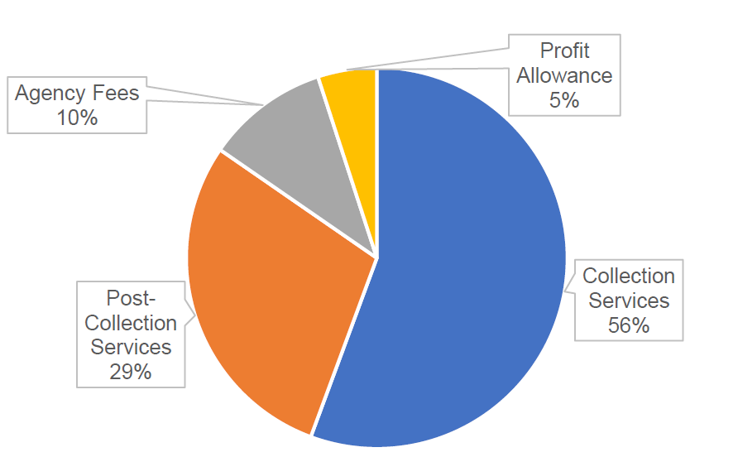
2025 Rate Adjustment and New Methodology
Overall Look at Solid Waste Costs

Slide 11
2025 Rate Adjustment and New Methodology
New Rate Adjustment Methodology
  Enhances rate stability, predictability, fairness, transparency, ease of administration, and cost-effectiveness
  Capped CPI adjustments to MCD Collection and Post-Collection Services – 2% floor, 5% ceiling with roll-overs
  Revenue balancing mechanism – surplus or shortfall revenues carries forward to future years
  Less frequent cost-based adjustments – no more frequently than every 5 years
  Extraordinary Adjustments – E.g., CARB fleet electrification mandate

Slide 12
Regional Comparison
Monthly 32-Gallon Cart Rates

Slide 13
Regional Comparison
Monthly 64-Gallon Cart Rates

Slide 14
Regional Comparison
Monthly 96-Gallon Cart Rates

Slide 15
Regional Comparison
Monthly 2-CY Bin Rates

Slide 16
Recommended Action
Receive presentation on recommended adjustments to solid waste rates effective January 1, 2025
Set a public hearing for January 16, 2025, pursuant to Article XIIID of the California Constitution (Proposition 218)
Provide direction to issue 45-day notices to solid waste customers regarding rate adjustment public hearing and protest instructions

