Slide 1
South County Sanitary Services
Jeff Smith

Slide 2
Recycling 101
How Recycling started
AB939 – 1989
50% diversion – the creation of recycling programs in CA
AB341 – 2012
Goal of 75% diversion by 2020
Increased recycling mandates for commercial businesses
Beginning of organics collection programs
China now receiving most of the US recyclables

Slide 3
Recycling 101 Worldwide
2012 – Global Recycling Markets begin to stir
China begins to what appears to be market pricing manipulation for commodities creating market volatility
Global Markets are shaken
Mixed Paper is turned away
Cold Canyon Processing starts to prepare
2013/2014– China establishes the “Green Fence” initiative
Defines acceptable plastics
2017 – China begins a new campaign called the “China Sword”
Industry is changed forever

Slide 4
Cold Canyon Process/ SCSS Respond
Sort line speed is cut almost in half
Labor increased by 100%
Work with IWMA
SCSS created a recycle app to address “Wishful Recycling”
SCSS attempting to hire a recycling educator
Look for and promote innovative solutions like we did with the digester

Slide 5
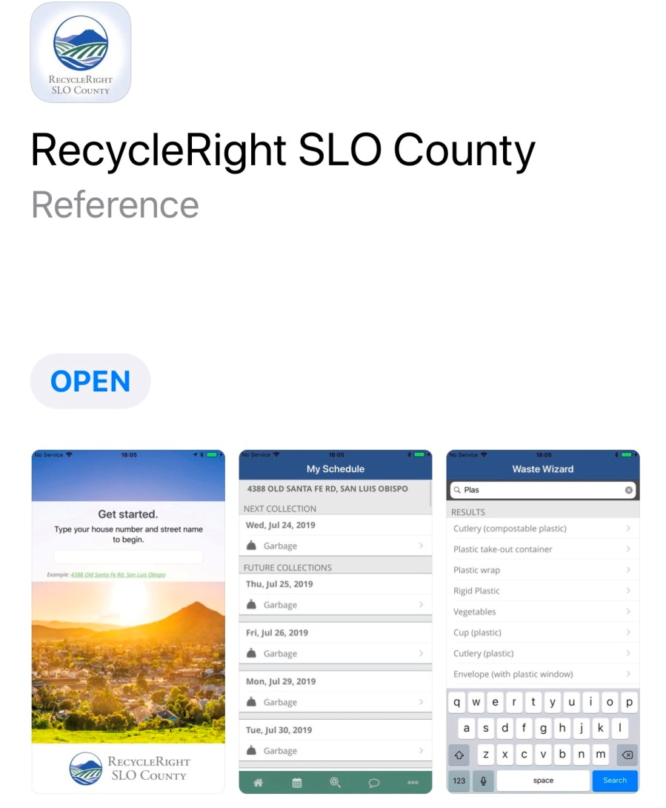
SCSS Recycle Right
Use the new recycle app to make sure you are recycling right
If in doubt, throw it out
Do not bag your recycling
Tell others

Slide 6
2019 Update
Q4 of 2018 prices for some commodities dropped 60%
Q1 2019 Commodity values decrease by another 34%
Pricing and conditions are worse for recycling then when we started this rate case a year ago
Contract Labor is up by $800k since 2016
Recycling residual at all time high of approx 30% costing $100k per year due to “Wishful Recycling”

Slide 7
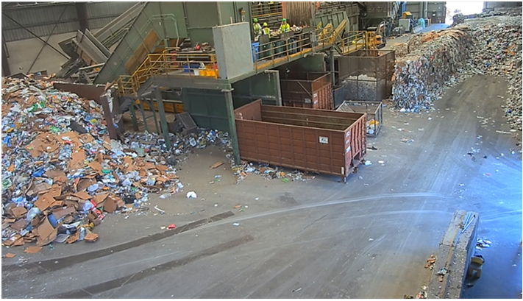
2019 Update - cont
Cost to maintain a 20 year old MRF has increased
Commodity pricing is expected to get worse before they get better
Market recovery is not expected until at least 2022
For more info GOOGLE ‘the state of recycling’

Slide 8
Final thoughts
Our company remains strong and is committed to serving our community
We are committed to doing the right thing, at the right time. We will not be throwing away recycling like some of our competitors have done
We are committed to continue the work of building and developing relationships where recycling material can be processed at the lowest possible cost
We are committed to innovation and the future keeping costs as low as possible

