Slide 1
Facilities and Resources Report
APRIL 18, 2024

Slide 2
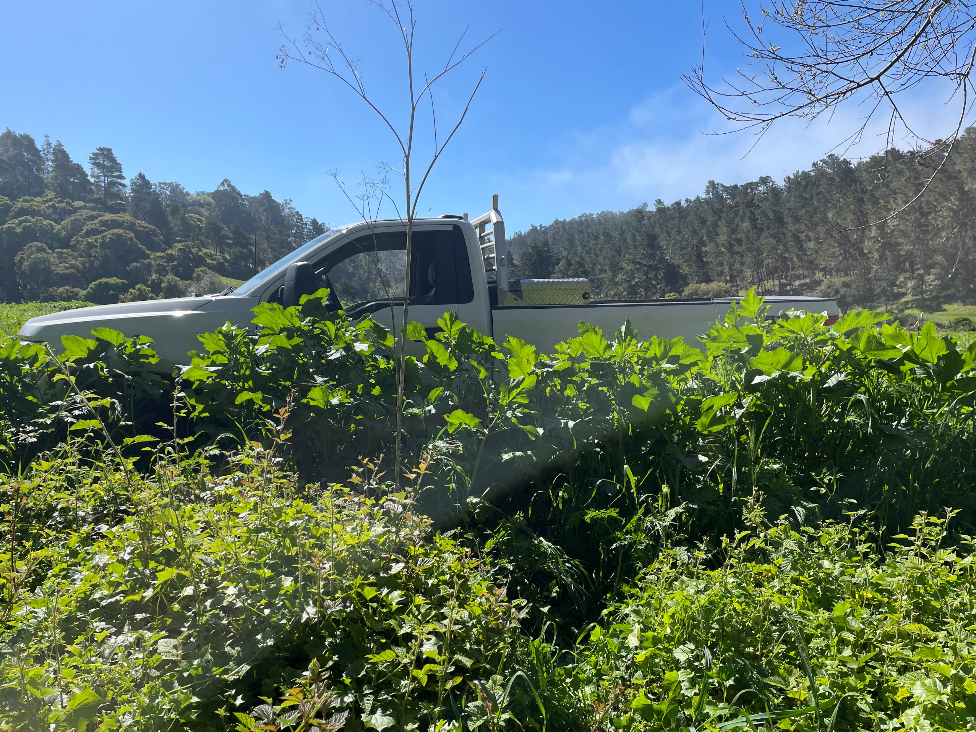
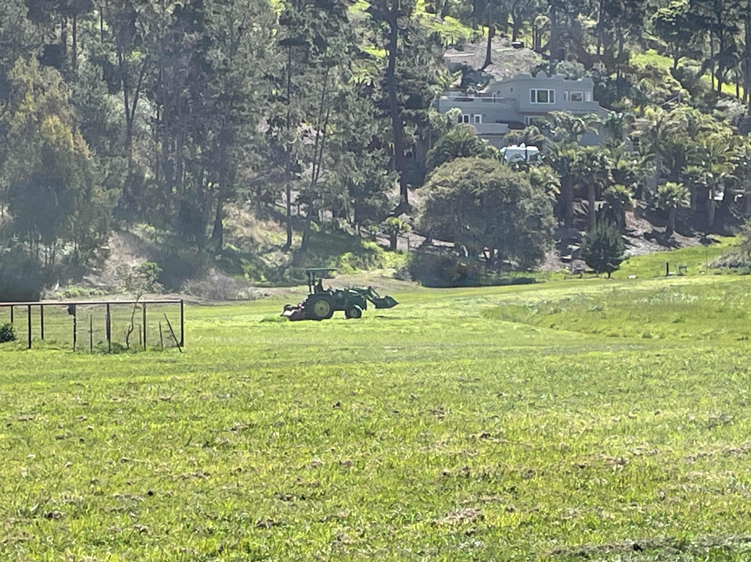
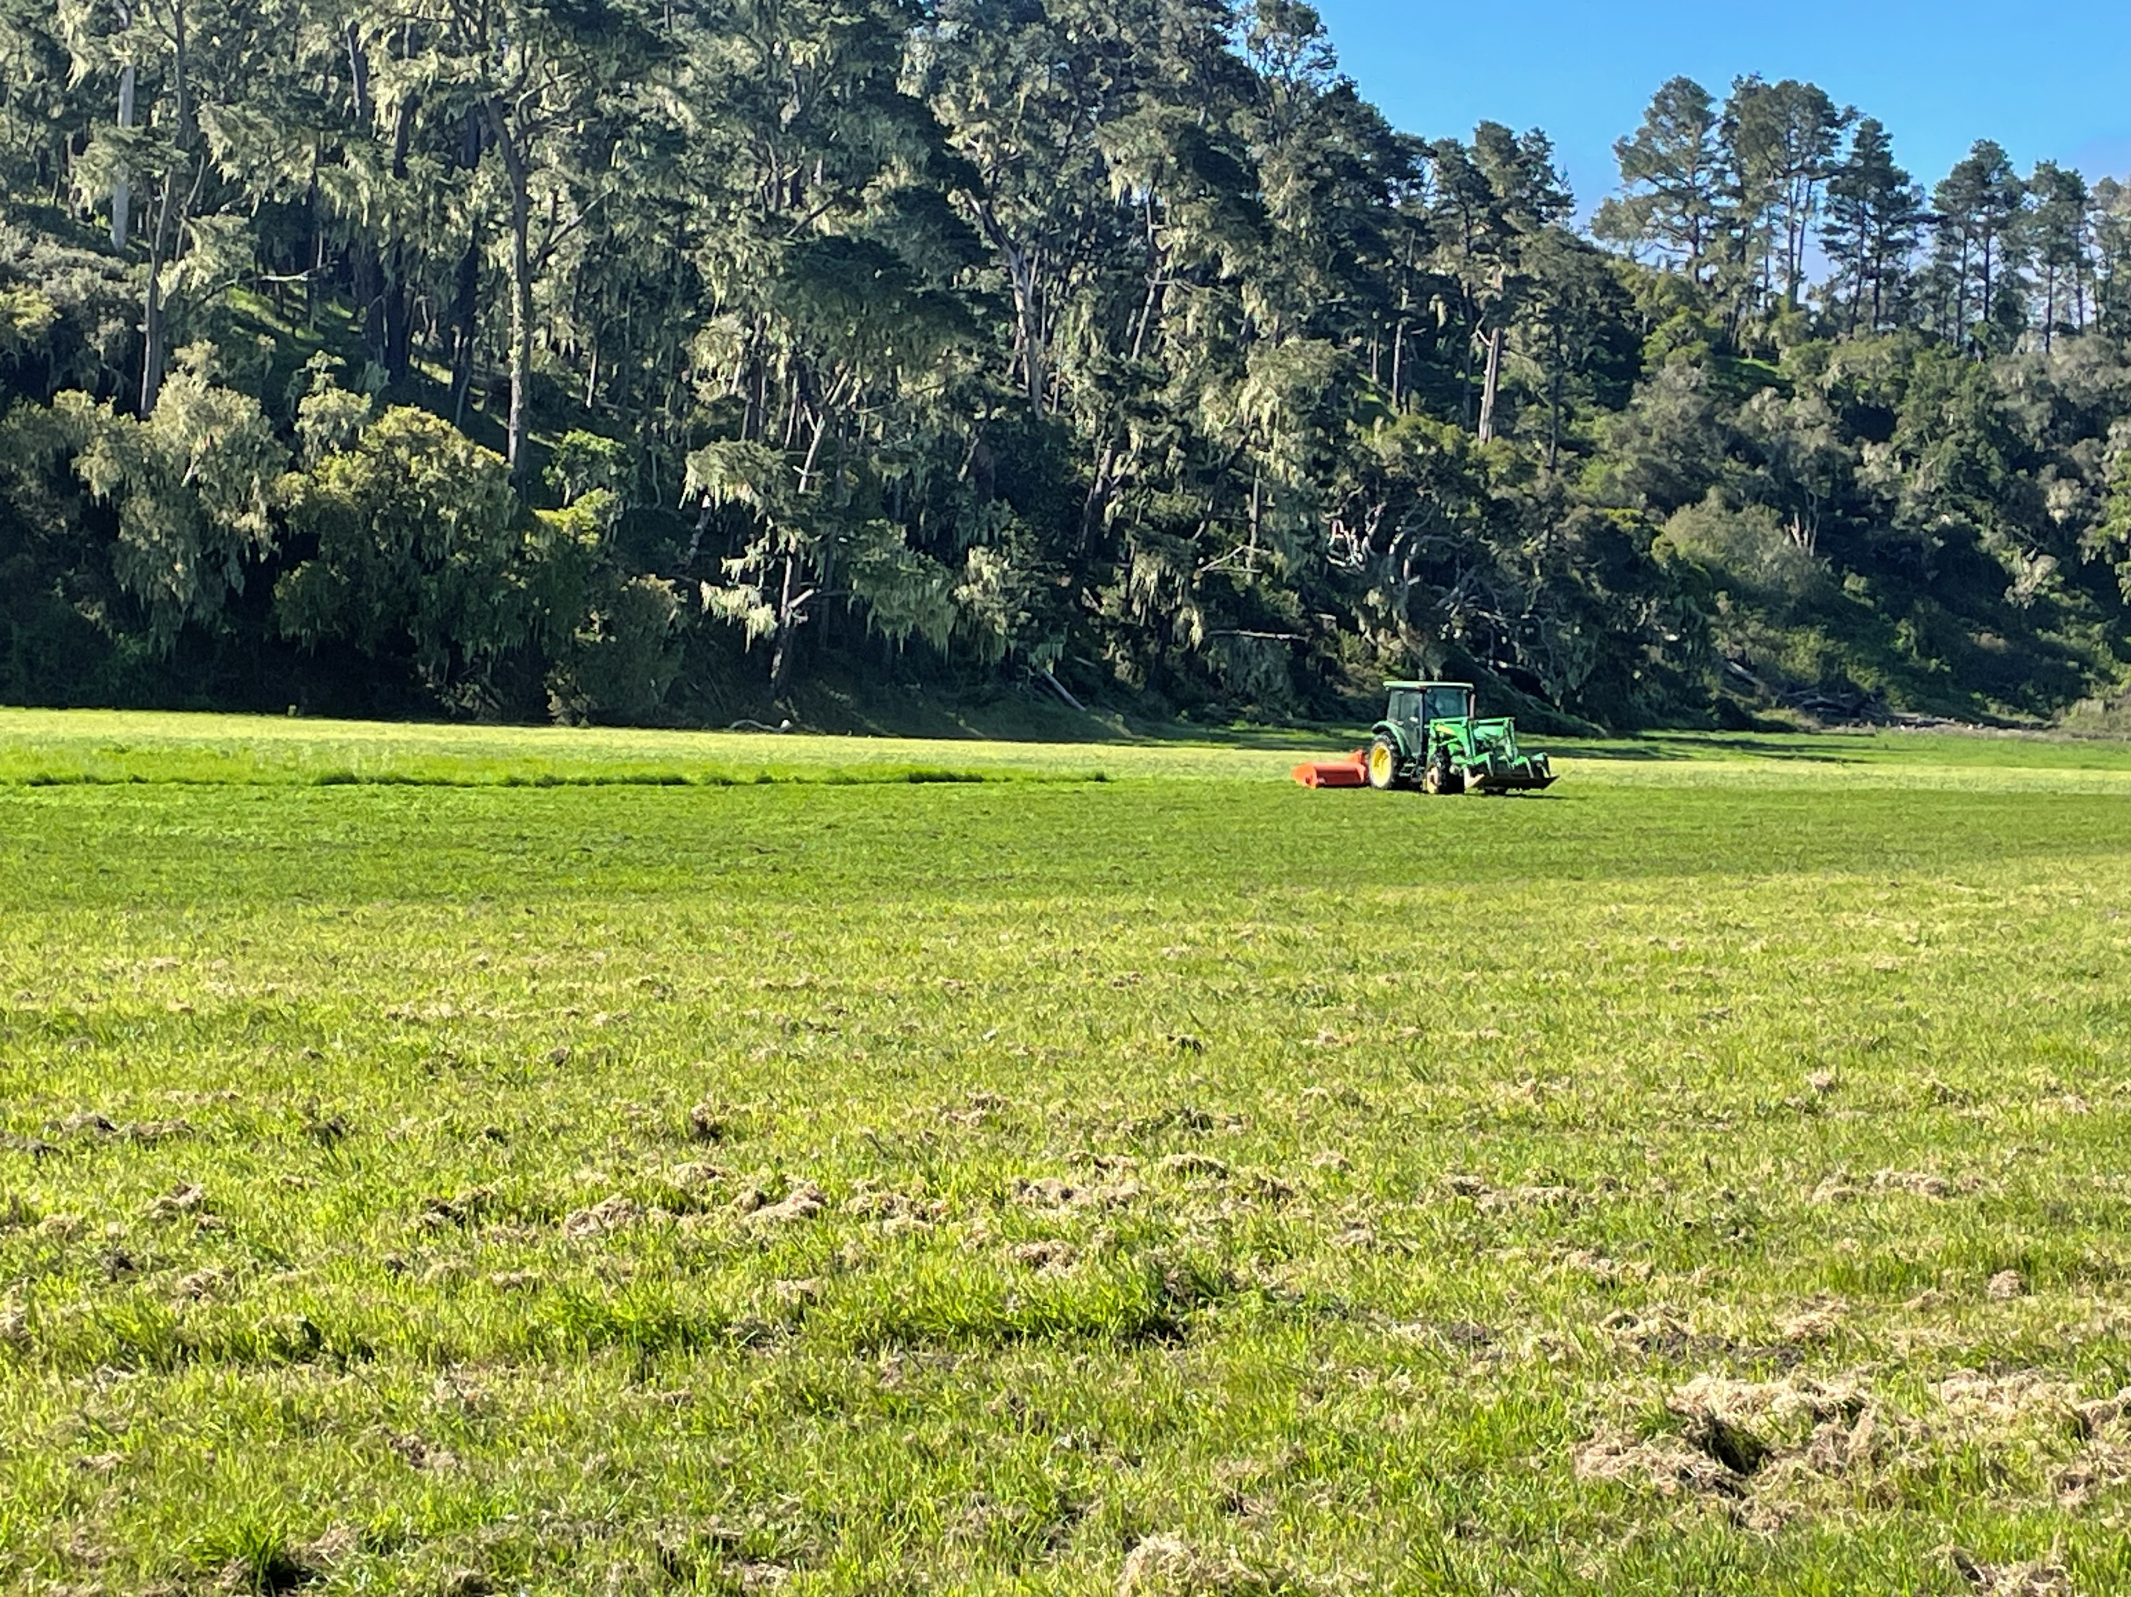
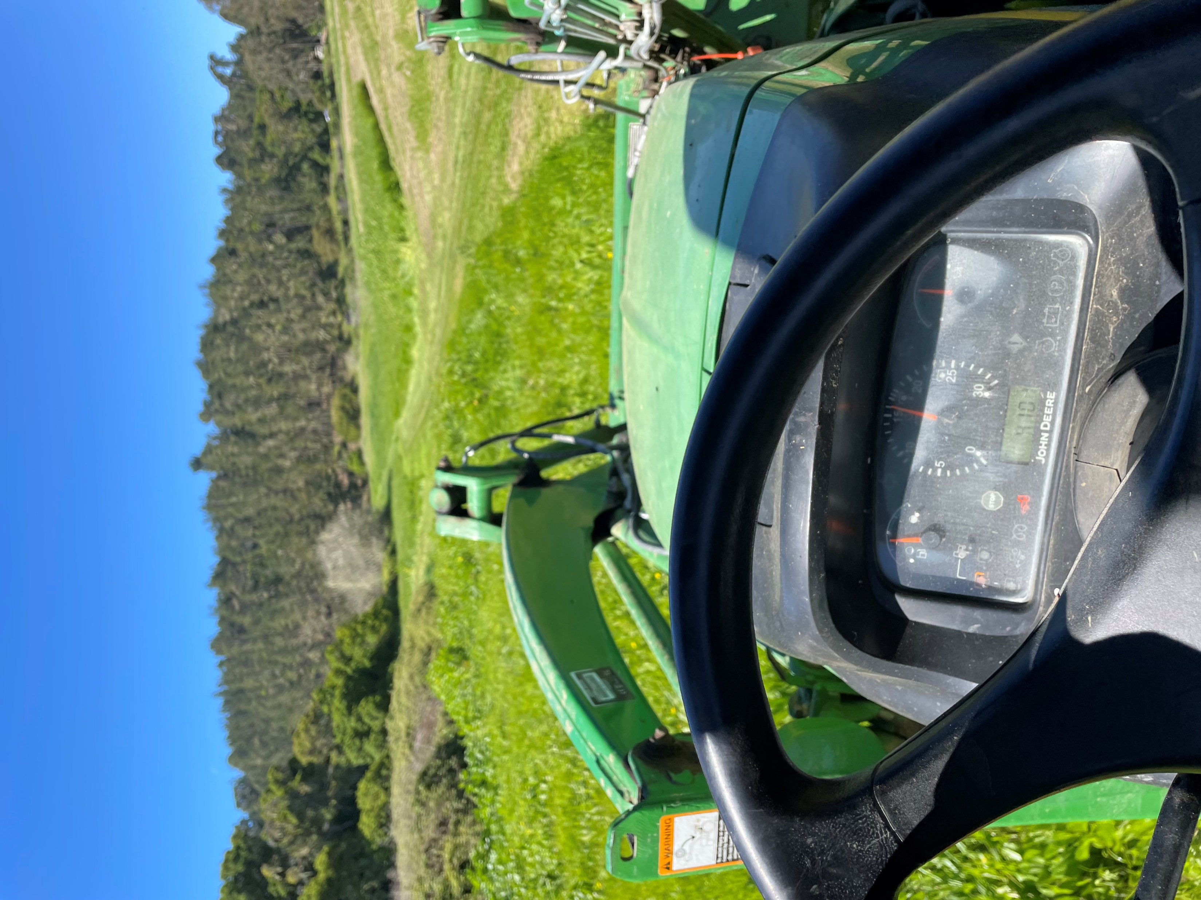
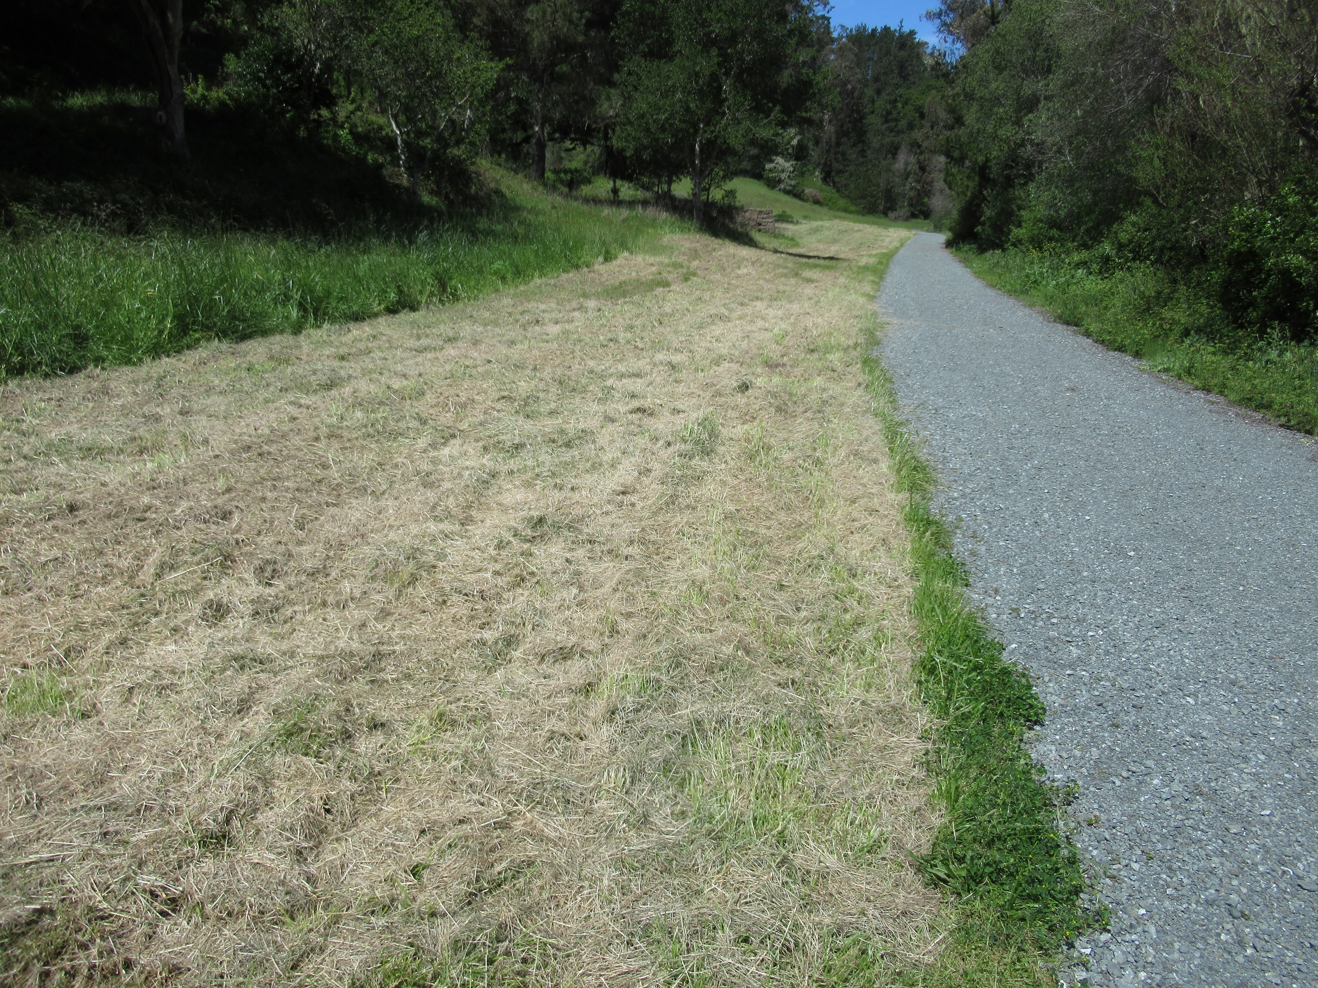
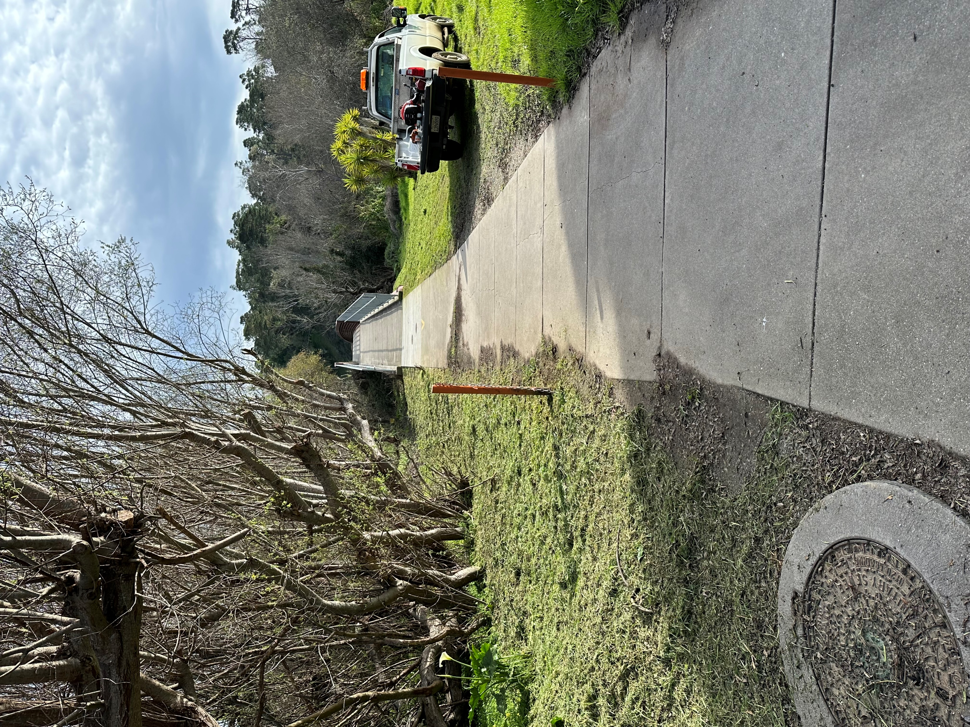
WEED ABATEMENT
Mowing of the East Ranch started with weed whacking on several CCSD lots within the community.

Slide 3
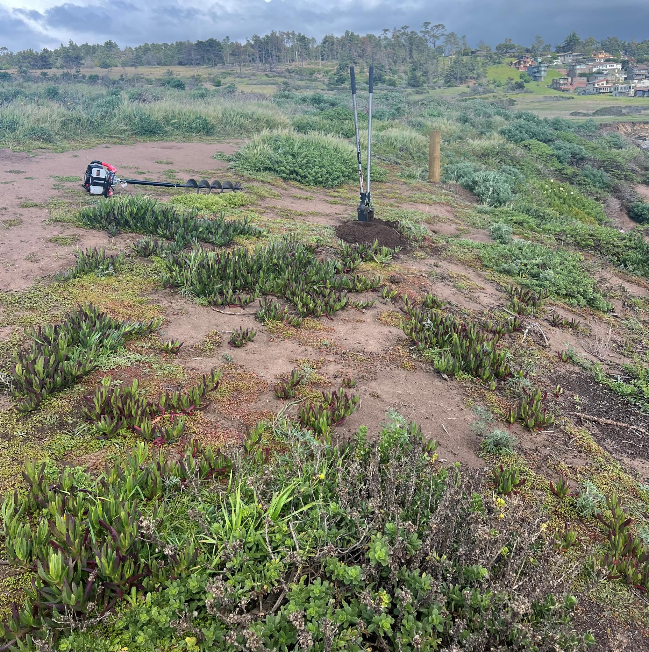
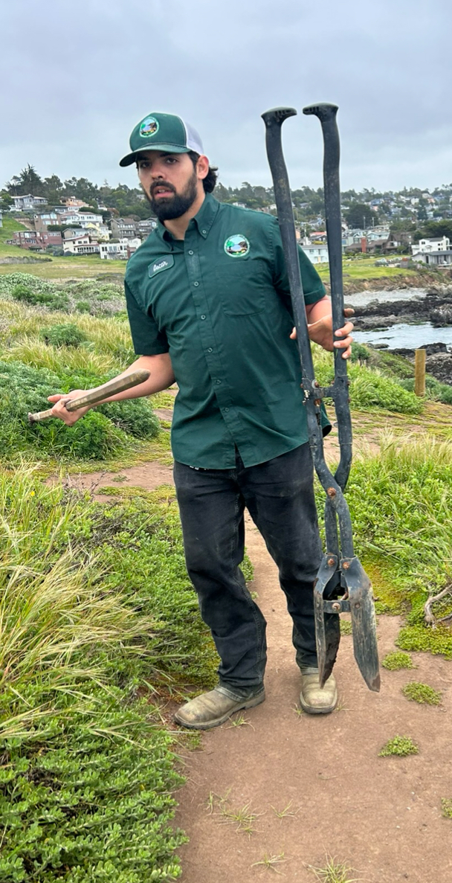
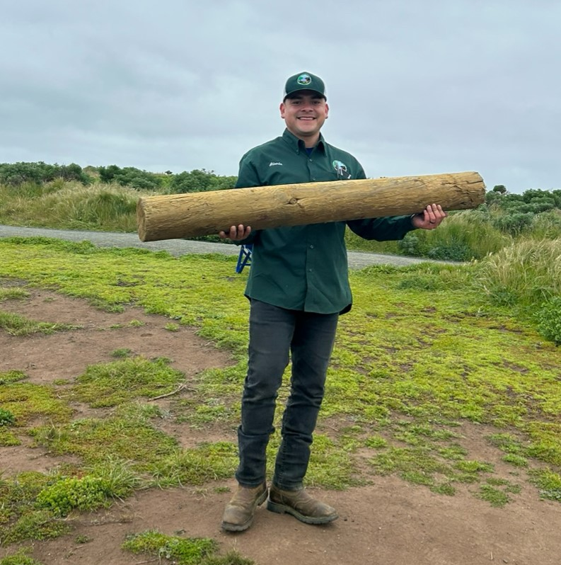
Fiscalini Ranch Preserve
We have been patrolling more of the Ranch. There have been reports of people entering cliffs and areas where seals are giving birth. With the FFRP, we have decided to cable off certain areas. Fire Break mowing will be starting in May for the first pass. Due to the wet weather. We do have concerns about fawns in the tall grass. We will lead with an ATV prior to mowing for safety.

Slide 4
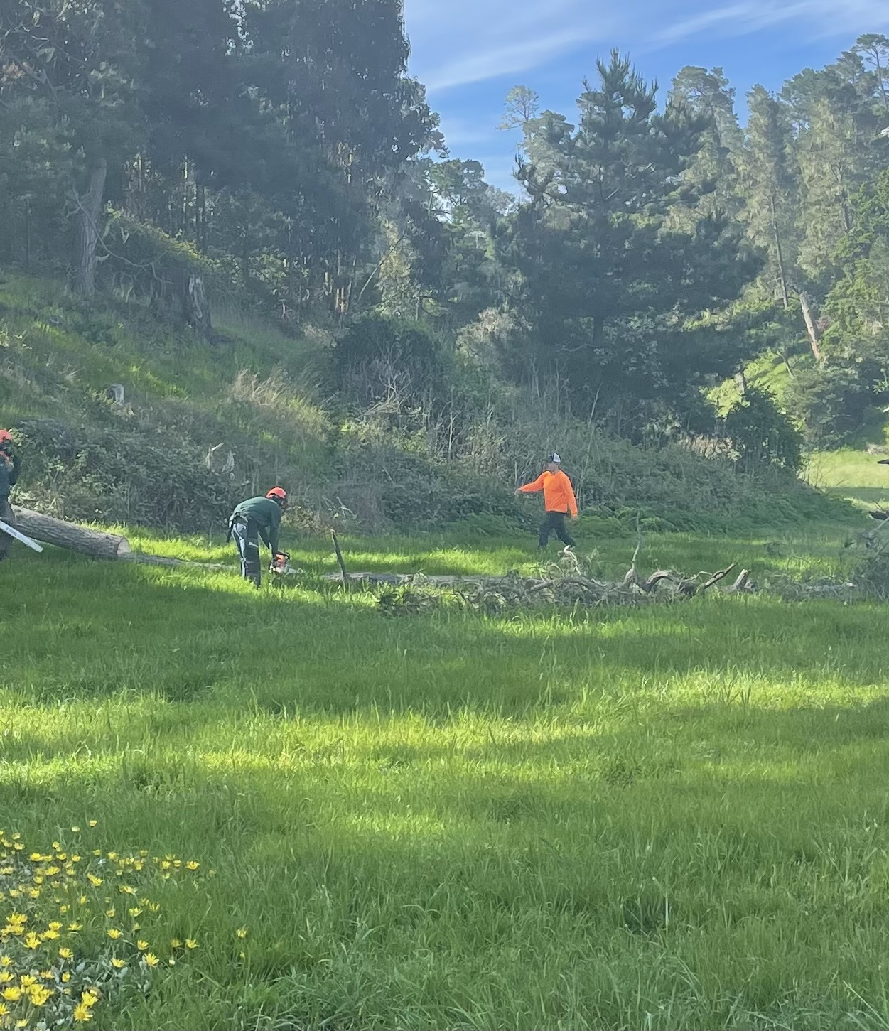
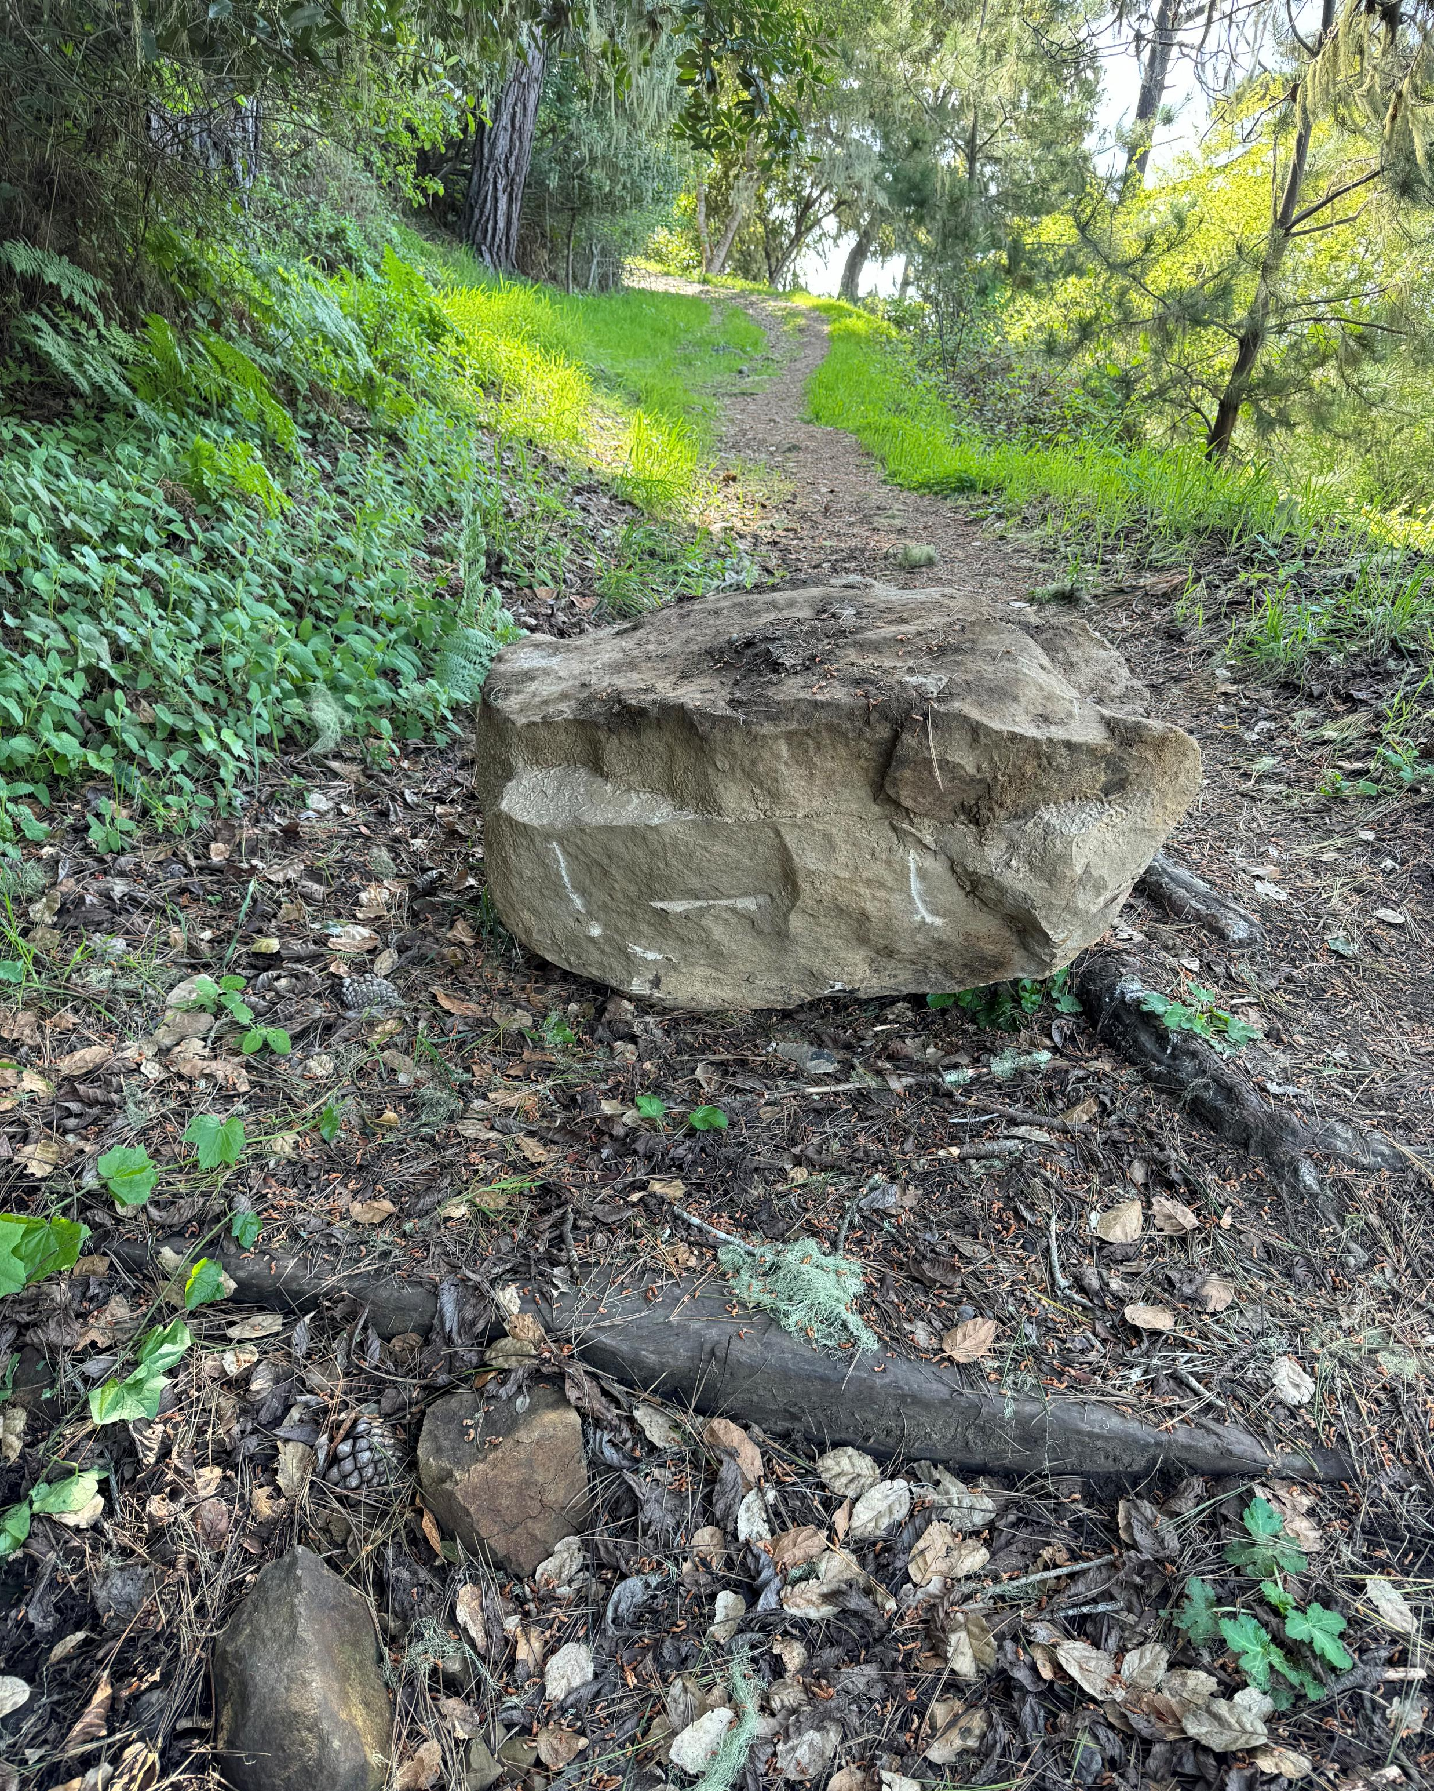
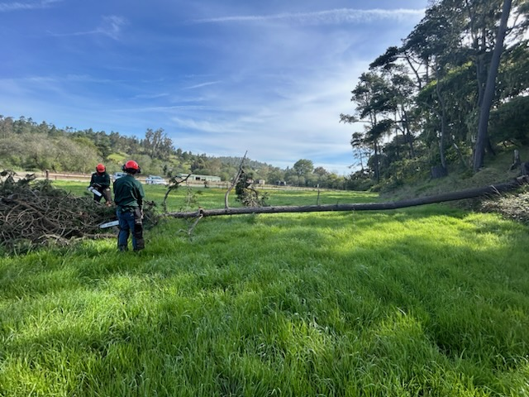
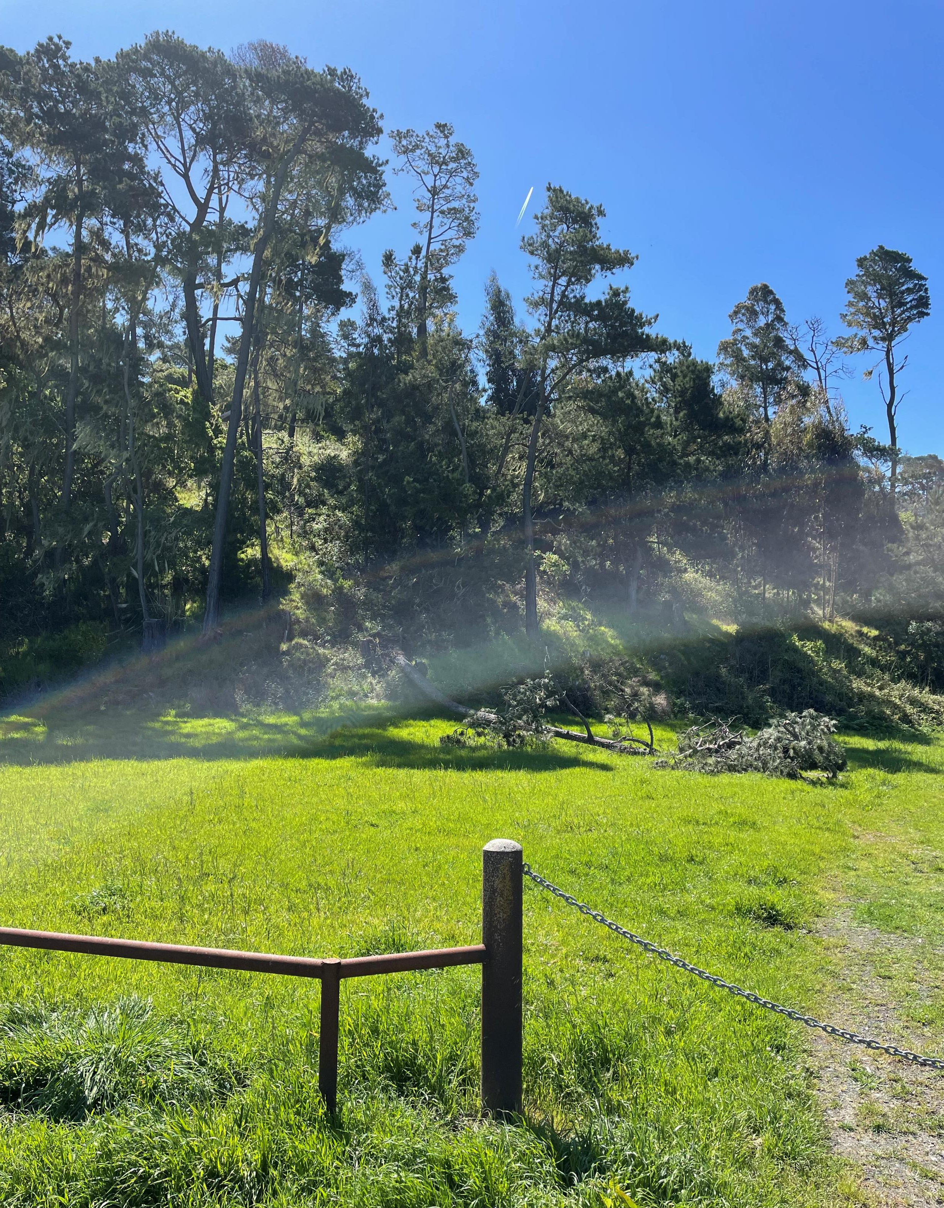
Trails and Open Spaces
Perfect placement for a non-driving trail. Been working ON KEEPING open spaces CLEAR WITH DOWN TREES OR Branches.

Slide 5
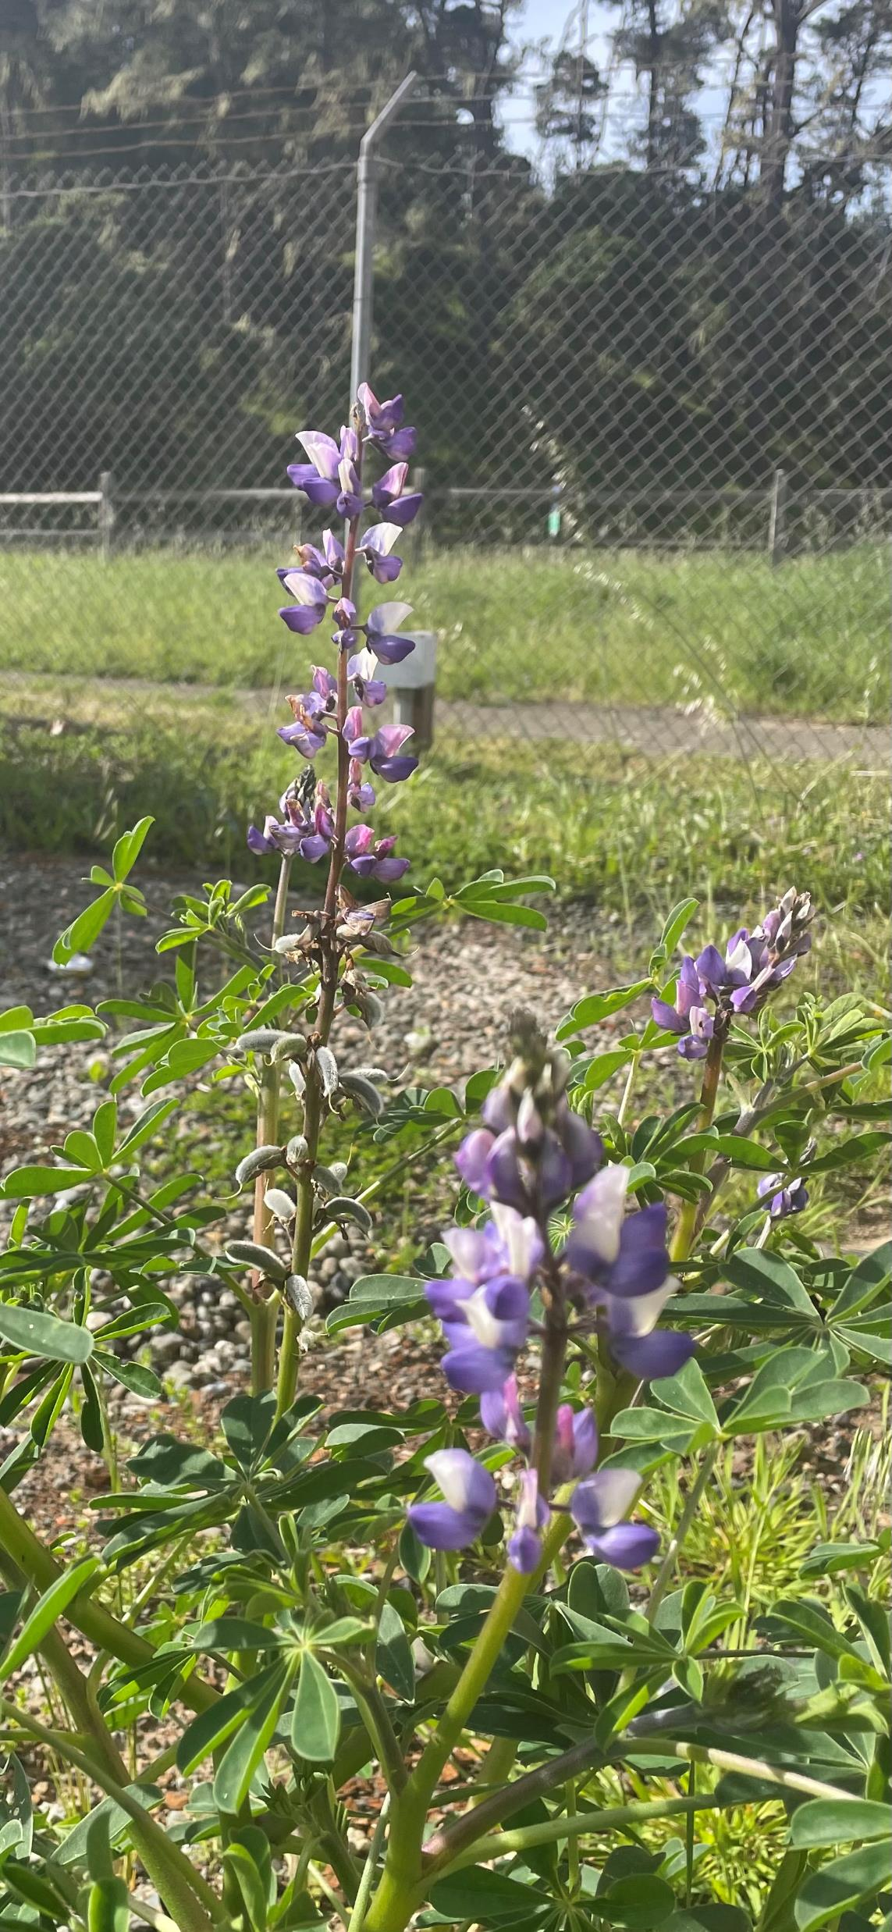
Moving forward
Our work will consist of the CCSD Lots and fire breaks for the next couple of months, with the small projects as they come into our department. With the effort of the crew, we will push forward to meet the guidelines of the district and community.

Slide 6
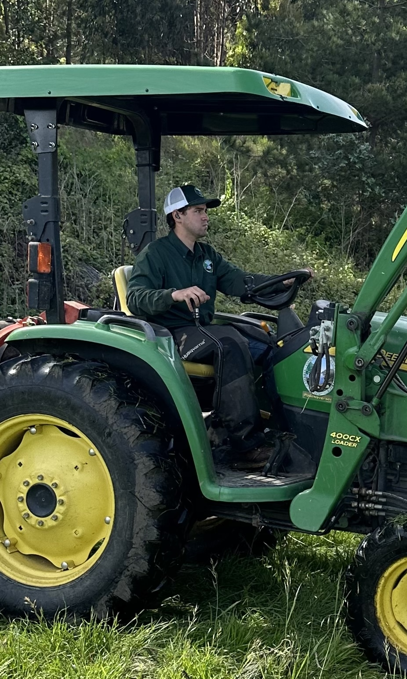
Patrick Moloney He is from Cambria and has been selected for our crew after several applications and interviews. With his experience and knowledge, our department will be well developed with workers and support for the needs here in the district. He has been on our crew for a week. I want to introduce him to the Board currently.

