Slide 1
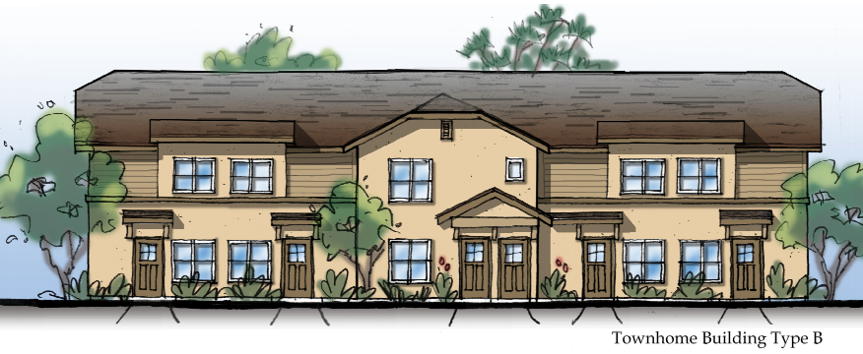

Cambria Pines
100% Affordable Apartments
Ken Trigueiro
CEO

Slide 2
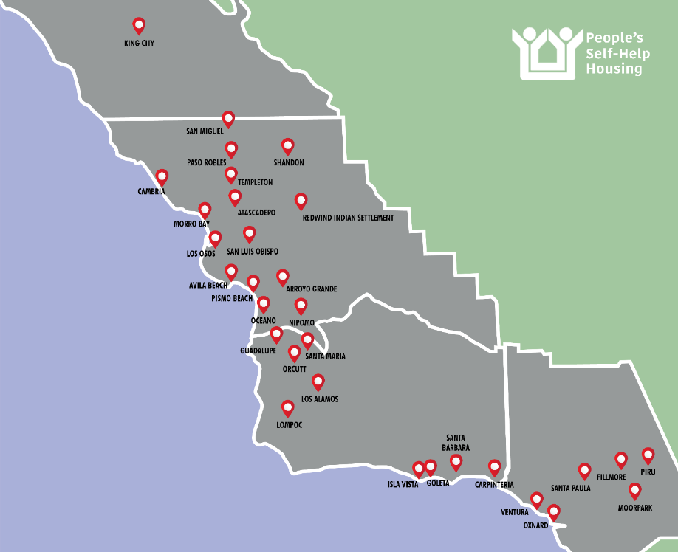

Company & Mission
Founded in 1970
Longest-serving affordable housing nonprofit on the Central Coast
Headquarters in San Luis Obispo
10,000 residents
Four coastal counties
On-site resident services

Slide 3
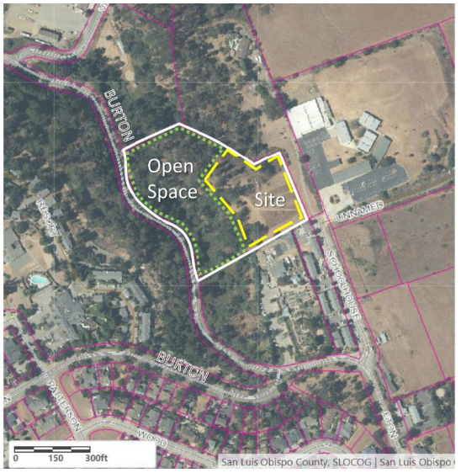
Proposed Project
33 Affordable Units
  Deed Restricted for 55 years to serve very low and low income residents
2,880 S.F. Community Service Space
2.04 acres development area
2.83 acres dedicated open space
Notes:
CAN/MAY BE DELETED BASED UPON CONTENT/DETAIL IN STAFF REPORT AND PRESENTATION -TS

Slide 4
Entitlement & Plan Check Milestones
CCSD Extension of Will Serve (Jan. 2023)
County Land Use Entitlements Re-Approved (June 2023)
Building/Grading Permit Submittal (July 2023)
County “Ready to Issue” Letter for Building
and Grading Permits (Feb. 2024)

Slide 5
Funding Milestones
SLO County HOME & HOME ARP Funding (Feb. 2022)
BUILD Low Emission Energy Incent. Grant (June 2023)
CTCAC/HCD Multi-Family Housing (Not Awarded) (Aug. 2023)
National Housing Trust Fund (Not Awarded) (Feb. 2024)
CTCAC Tax Credit Application (Pending) (July 2024)

Slide 6
Anticipated Next Steps
CTCAC Tax Credit Awarded (Oct. 2024)
Construction Loan Closing (Mar. 2025)
Commence Construction (Mar. 2025)
Complete Construction (Apr. 2027)

Slide 7
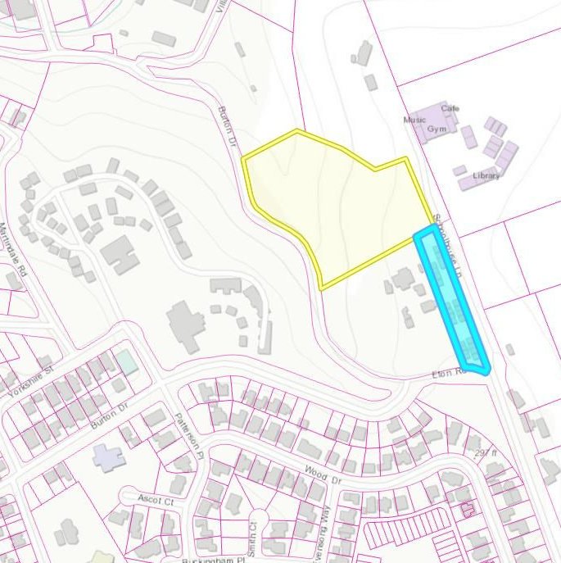
The Need for Affordable Housing
Schoolhouse Lane Apartments Waitlist
24 apartment homes
169 waitlist applicants, representing 369 interested persons
Existing Cambria residents
65% of Schoolhouse Lane Residents work in Hospitality
Cambria Pines
Schoolhouse Lane Apts.

Slide 8
Cambria Pines Apartments
PSHH accepts all proposed conditions of approval.
Respectfully request approval of staff’s recommendation to extend the Water “Intent to Serve” letter for this critical affordable housing project.
PSHH looks forward to securing financing and commencing construction. We appreciate your support and patience.
Thank you!

